Slide 1
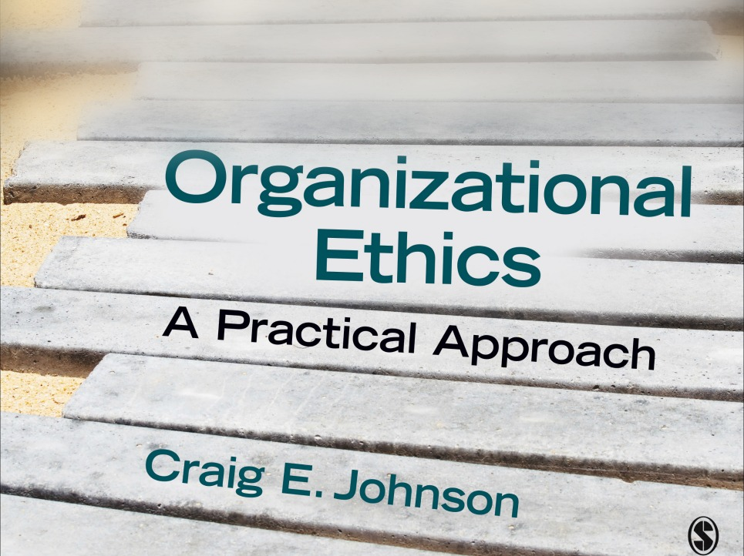
Chapter 6: Ethical
Conflict Management

Slide 2
Conflict in Organizational Life
Conflict is a daily occurrence in every organization
Sources of organizational conflict
  Interests
  Data
  Procedures
  Values
  Dysfunctional relationships
  Roles
  Communication
Definition: “an expressed struggle between at least two interdependent parties who perceive incompatible goals, scarce resources, and interference from others in achieving their goals.” (Hocker & Wilmot)

Slide 3
Becoming an Ethical Conflict Manager
Step 1: Recognize the Differences Between Functional and Dysfunctional Conflicts
  Functional: centered on the task and content of messages; problem focused
  Dysfunctional: centered on personalities and marked by
    Conflict spirals or avoidance
    Strong negative emotions

Slide 4
Becoming an Ethical Conflict Manager
Step 2: Manage Your Emotions
  Cooling down
    Identify your hot buttons
  Slowing down
    Have a backup plan
    Relax
  Engaging constructively
    Enter into conflict resolution
    Perspective take
    Listen carefully
    Seek win-win solutions

Slide 5
Becoming an Ethical Conflict Manager
Step 3: Identify Your Personal Conflict Style
  Styles
    Avoiding (low concern for self/others)
    Accommodating (low concern for self/high concern for others)
    Compromising (moderate concern for self/others)
    Competing (high concern for self/low concern for others)
    Collaborative (high concern for self/others)
  Each style can be effective and ethical in certain situations but collaboration is most ethical across a variety of contexts

Slide 6
Becoming an Ethical Conflict Manager
Step 4: Develop Conflict Guidelines
  Monitor your personal behavior and the behavior of the other party for signs of destructive conflict
  Identify common goals and interests
  Develop problem solving guidelines
  Focus on mutual gain
  Create a process for generating productive conflict

Slide 7
Becoming an Ethical Conflict Manager
Step 5: Employ Collaborative Conflict Management Tactics
  Analytic remarks
    Descriptive statements—non-evaluative observations
    Disclosing statements—non-evaluative statements about events that the other party can’t observe
    Qualifying statements—qualify the nature and boundaries of the conflict
    Solicitation of disclosure—seek information
    Solicitation of criticism—identify criticism of the self
  Conciliatory verbal messages
    Supportive remarks—communicate positive affect
    Concessions—signal flexibility
    Acceptance of responsibility—admit personal responsibility

Slide 8
Becoming an Ethical Conflict Manager
Step 6: Be Prepared to Apologize
  Complete (ethical) apologies contain
    Acknowledgement of the offense
    Expression of remorse
    Explanation of behavior
    Offer to repair the damage (reparations)
  Will also need to offer forgiveness—let go of resentment and revenge

Slide 9
Resolving Conflict Through Ethical Negotiation
Negotiation: resolving disputes by generating a joint agreement or solution
Ethical issues in negotiation
  Deceit/deception
  Distribution of outcomes or benefits (fairness)
  Impact on those outside the bargaining table
    Conflicts of interest when acting as agents for outside parties

Slide 10
Resolving Conflict Through Ethical Negotiation
Adopt an integrative (win/win) approach instead of a distributive (win/lose) approach
Steps of Principled (Integrative) Negotiation
  Separate the people from the problem (focus on the human dimension)
  Focus on interests, not positions (on the why of a negotiating stance)
  Invent options for mutual gain (think win/win)
  Insist on objective criteria (fair standards)

Slide 11
Combatting Aggression
Types of aggression
  Physical-verbal: destructive words or deeds
  Active-passive: doing harm by acting or failing to act
  Direct-indirect: doing harm directly or through an intermediary
  Sources of Aggression
    Personal (individual factors like personality and low self-esteem)
    Social (triggered by other people, unfairness and role models)
    Contextual (elements of the situation like stressful working conditions)

Slide 12
Combatting Aggression
Resistance is risky but necessary
Best to prevent aggression before it starts
  Carefully screen employees
  Reduce injustice, eliminate aggressive role models
  Cut back on tight supervision and unnecessary rules; create pleasant working conditions

Slide 13
Preventing Sexual Harassment
Definition: a distinctive form of aggression overwhelmingly directed at women by men
Types
  Gender harassment—gender based comments and behaviors designed to demean women
  Unwanted sexual attention—verbal and nonverbal
  Sexual coercion—forcing employees into sexual activity
Legal definitions
  Quid pro quo—”something for something”
  Hostile work environment—forced to submit to conditions not required of other workers

Slide 14
Preventing Sexual Harassment
Determinants of harassment
  Less equalitarian views
  Males hope to win sexual favors and other payoffs
  Leaders don’t take complaints seriously
  Preserves male-dominated organizational systems
Prevention steps
  Adopt a zero-tolerance policy
  Attack gender stereotypes through training
  Increase the proportion of women in the organization

Slide 15
Preventing Sexual Harassment
Increase the moral intensity of sexual harassment
  Make aggressors aware of the effects of their actions
  Encourage consensus about the definition and immorality of sexual harassment
  Shorten the time between conduct and consequences
  Emphasize similarities
  Promote individual responsibility

